Slide 1
Lending Club loans Report

Slide 2
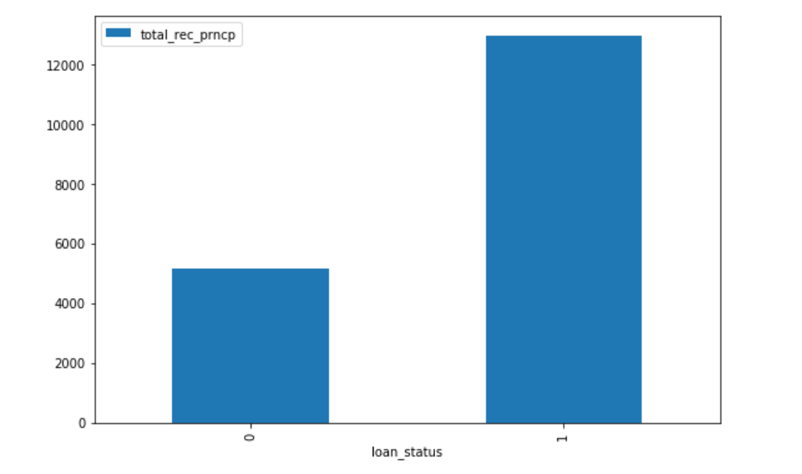
Loan_status vs total_rec_prncp

Slide 3
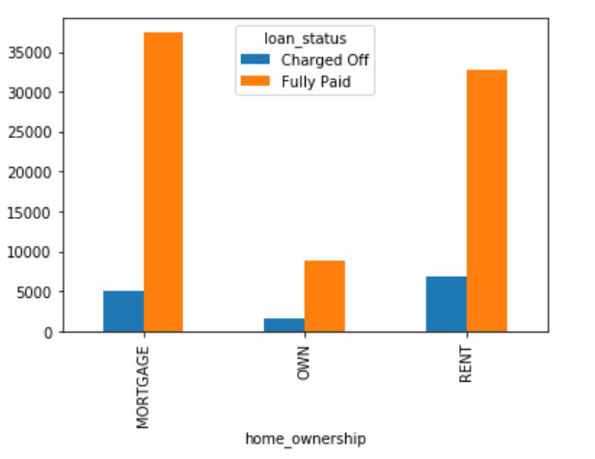
Loan_status vs home_ownership

Slide 4
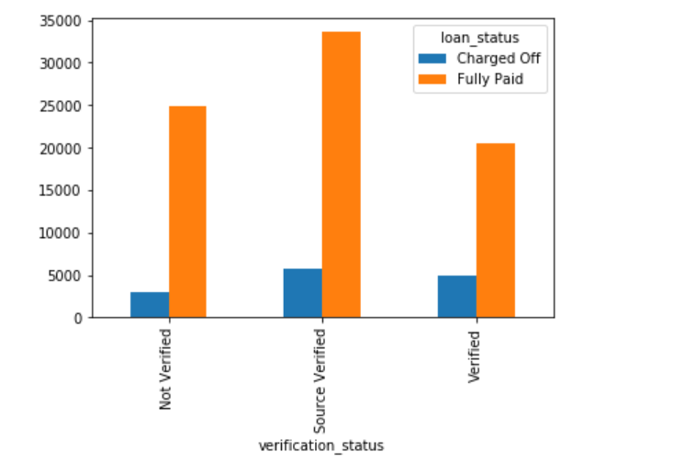
Loan_status vs verification_status

Slide 5
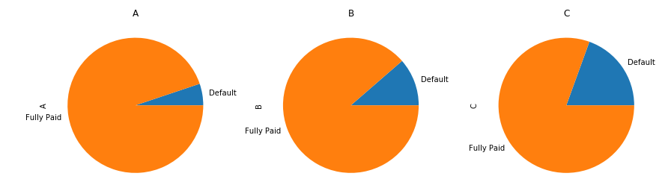
Distribution of loan_status w.r.t each grade

Slide 6
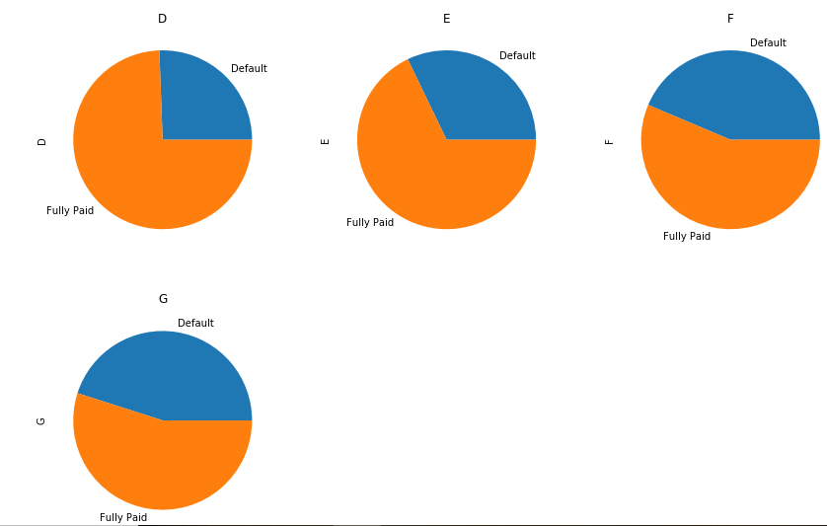
Distribution of loan_status w.r.t each grade

Slide 7
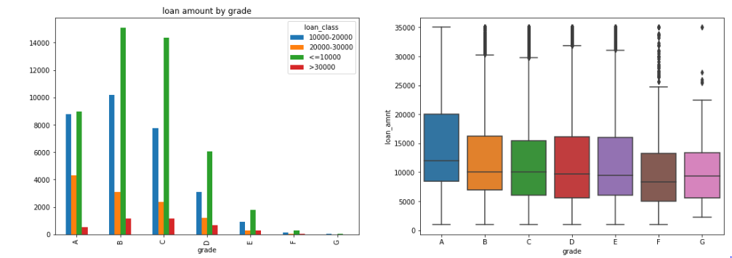
Loan amount vs grade

Slide 8
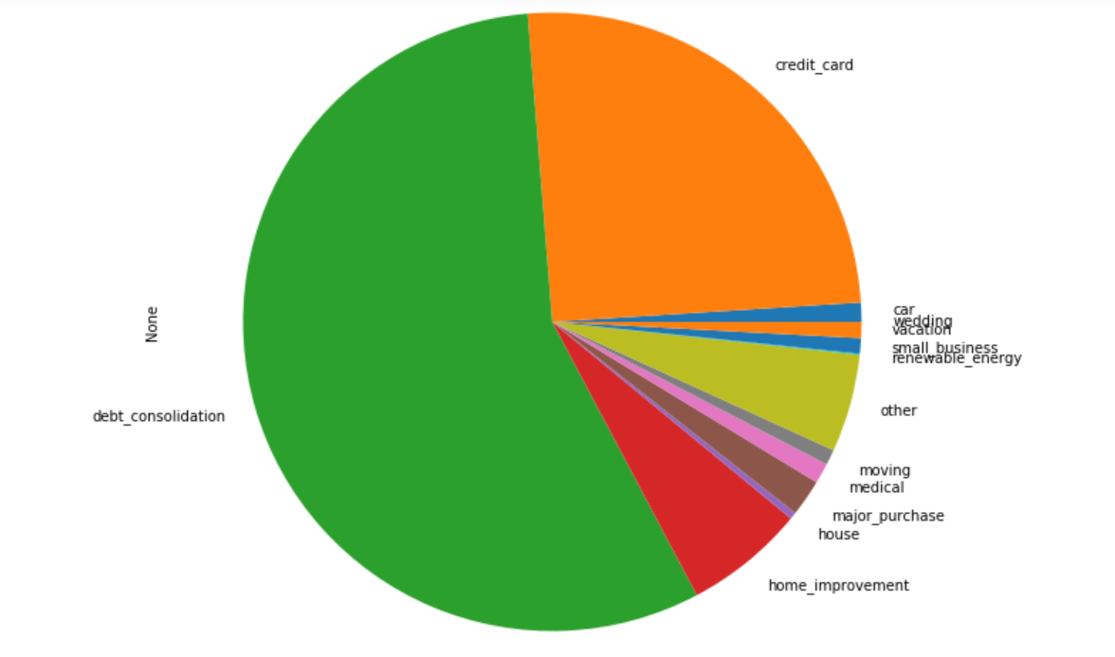
Purpose of loans

Slide 9
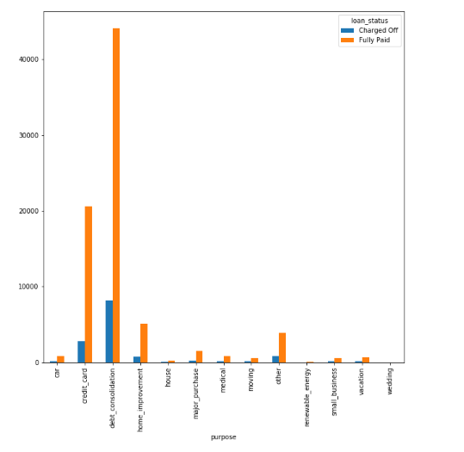
Loan_status vs Purpose

Slide 10
Chi-square test of dependence
The varibles that were dependent on loan_status
Home_ownership
Grade
int_rate
loan_amnt
annual_inc
verification_status
purpose

Slide 11
Data Cleaning and Preparation
Check for null values and remove columns with null values more than 70%.
The remaining columns were imputed.
Numerical and categorical variables were separated for further cleaning.
Few columns were dropped.
Then merged the two splits into one.

Slide 12
Machine Learning Models
Target Variable : loan_status with 2 categories fully paid & charged off
Logistic Regression Model: 99.15% accuracy
Decision Tree Model: 95.99% accuracy
Random Forest: 95.15% accuracy

Slide 13
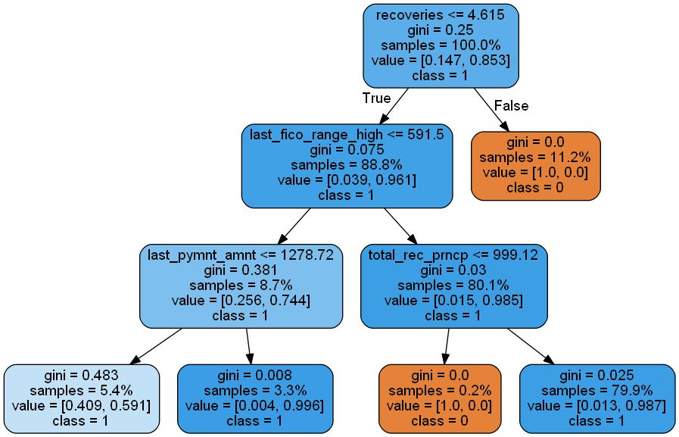
Decision tree

Slide 14
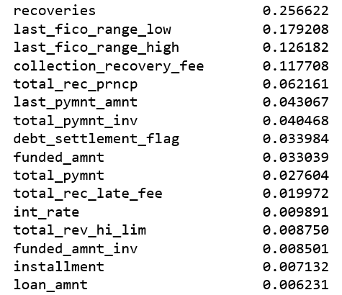
Feature_importances

Slide 15
Feature Selection
From the above result top 16 impotant features were selected.
Linear Regression Model: 99.06 % accuracy

Slide 16
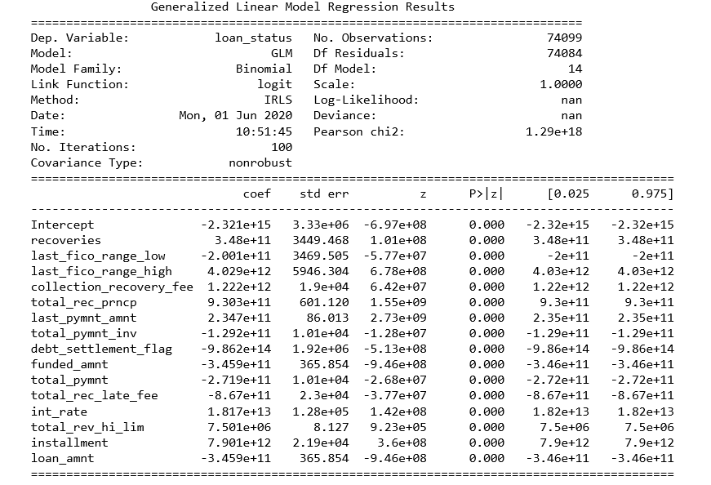
Linear Regression Model

Slide 17
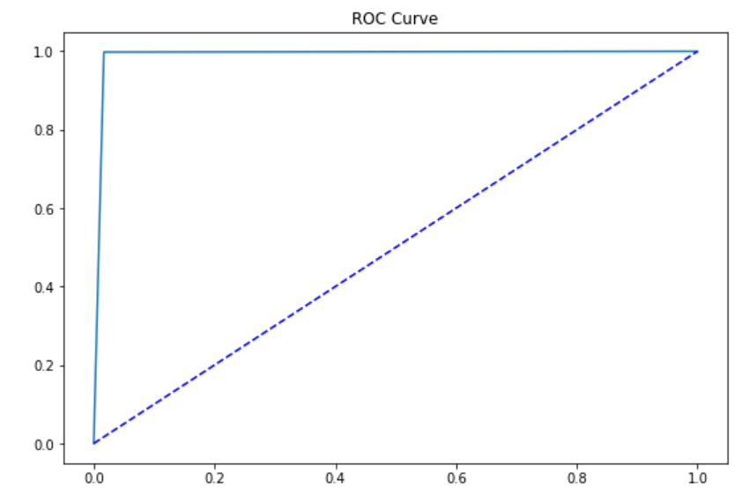
ROC Curve

Slide 18
Bgging Ensemble Model & Gradient Boosting
Using the bagging ensemble model on the top 16 features we got the accuracy is 99.6%.
Using the Gradient boosting model the accuracy is again 99.66% with number of best estimators to be 160.

Slide 19
Conclusion
Last payment amount is less than 1278.72 for fully paid customers.
last_fico_range is less than 591.5
If total_rec_prncp is less than 999.12 then he is charged off and if it is greater than 999.12 the he is a good customer

Slide 20
Thank you

